Slide 1
Responsive Website Design
William Jiang
2018-07-26

Slide 2
Responsive Web Design (RWD)
RWD is about adopting a more flexible, device agnostic approach to design for the web.
Device-agnostic because can’t know what devices people will use.
  Device-agnostic – anything designed to be compatible across different device types and operating systems.

Slide 3
Responsive Web Design
Start by building baseline experience.
Then use fluid grids, media queries to enhance the experience for devices with varying capabilities and larger screens.

Slide 4
Responsive Web Design
A responsive site is not a mobile site.
A responsive site is no more a mobile site than it is a desktop site or a tablet site.
Remember - device-agnostic

Slide 5
Responsive Web Design
In 2010 Ethan Marcotte wrote, “Responsive Web Design”.
Used three exiting tools:
  Media queries
  Fluid grids
  Scalable images
…to display sites on various devices of multiple resolutions

Slide 6
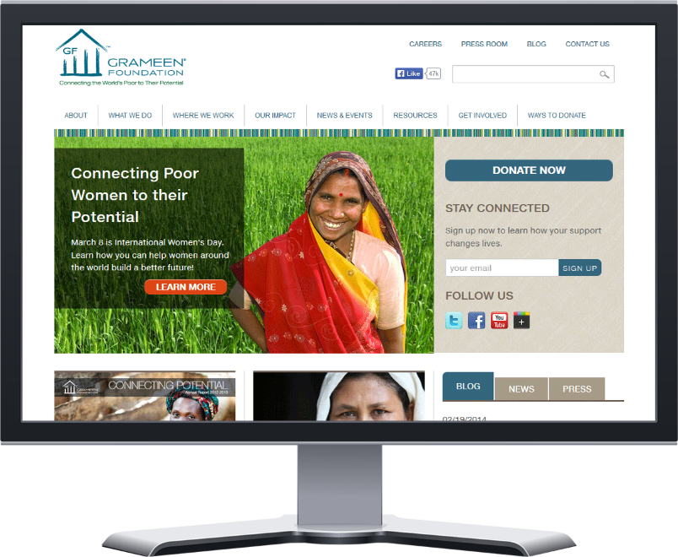
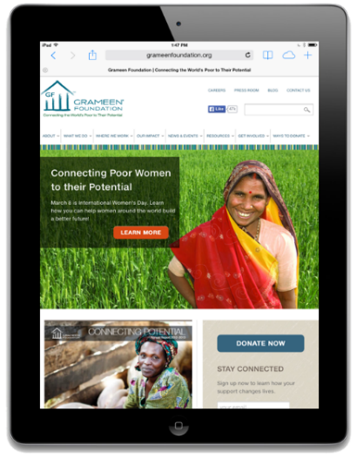

What Responsive Web Design Looks like
Desktop
Tablet
Mobile

Slide 7
http://www.responsinator.com/?url=billhd.com
通过该网站，可以查看网页在不同移动设备上的显示效果，如下页所示。

Slide 8
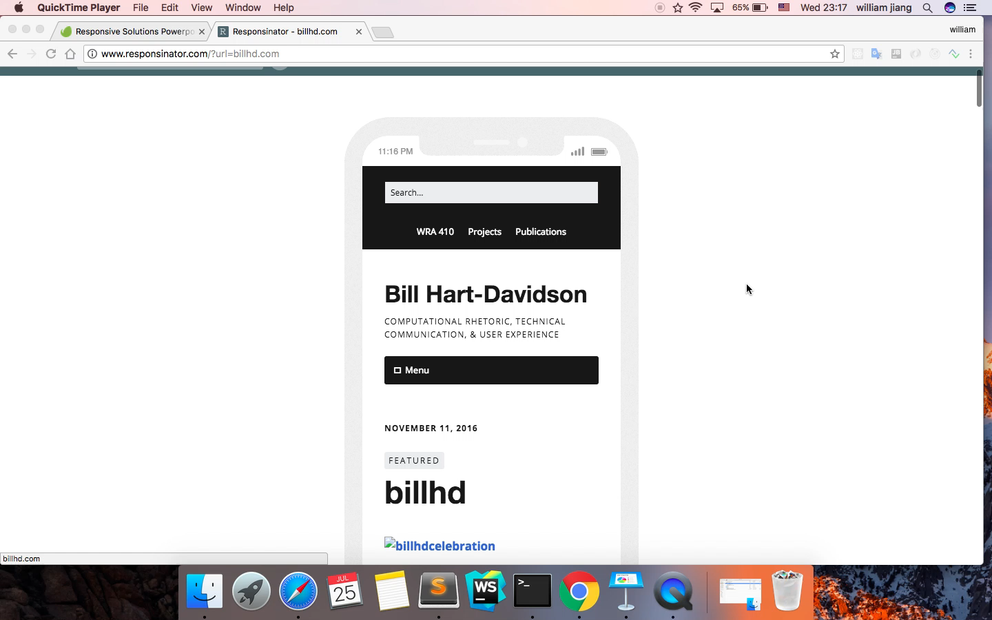

Slide 9
实现方式
- 媒体查询（Media queries），即根据不同设备分辨率特点，而采取不同的CSS规则。最长用的是根据浏览器宽度进行判断。
- 流式网格布局，即要求页面在布局时，尽量使用相对单位调整大小，如百分比。而不是绝对的单位，如像素。
- 图片等资源也应以相对单位调整（如最大宽度100%），同时针对不同设备需要提供不同分辨率的图片素材。
目前，响应式设计的基本实现主要依赖于以上几种方式，可根据项目需要自行实现，也可使用成熟的前端UI框架来实现。
Bootstrap目前是全球很受欢迎的一款前端UI库，尤其适用于响应式设计，移动设备优先的web项目。在众多响应式开发方案中，bootstrap框架以其响应式栅格系统，成熟的UI组件库，Sass变量编译等功能，使其具备高效、易用、可定制等特点。

Slide 10
Media queries
W3C created media queries as part of the CSS3 specification.
  Enhanced media types.
  Allows targeting of specific physical characteristics of the device.

Slide 11
Media queries
<link rel="stylesheet" type="text/css" media="screen and (max-device-width: 480px)" href=“min.css" />
a media type (screen), and
the actual query enclosed within parentheses, containing a particular media feature (max-device-width) to inspect, followed by the target value (480px).

Slide 12
Media queries
<link rel="stylesheet" type="text/css" media="screen and (max-device-width: 480px)" href="shetland.css" />
Asking device if its horizontal resolution (max-device-width) is equal to or less than 480px.

Slide 13
Media queries
Multiple property values in a single query by chaining them together with the and keyword
<link rel="stylesheet" media="only screen and (min-width:200px) and (max-width: 500px)" href=“small.css">
<link rel="stylesheet" media="only screen and (min-width:501px) and (max-width: 1100px)" href=“large.css">

Slide 14
Media queries
Can include MQ in CSS as part of a @media rule:
@media screen and (max-device-width: 480px)
{
.column { float: none; }
}

Slide 15
Fluid Grids
target ÷ context = result
Title – target width= 700px
700px ÷ 988px = 0.7085 *100 =70.85%
Context Width= 988px
Target column width = 329px 329px ÷ 988px = 33.29%

Slide 16
Fluid Grid Layout
#logo { background: url(images/logo.png); width: 600px; border: 1px #ccc solid; }
@media only screen and (max-device-width: 480px) {
#logo { background: url(images/logo_mobile.png); width: 440px; }
}
Resize the screen to see it working:
http://www.htmlgoodies.com/imagesvr_ce/3028/mq_demo.html
或者，下一页面演示这个例子的效果。

Slide 17

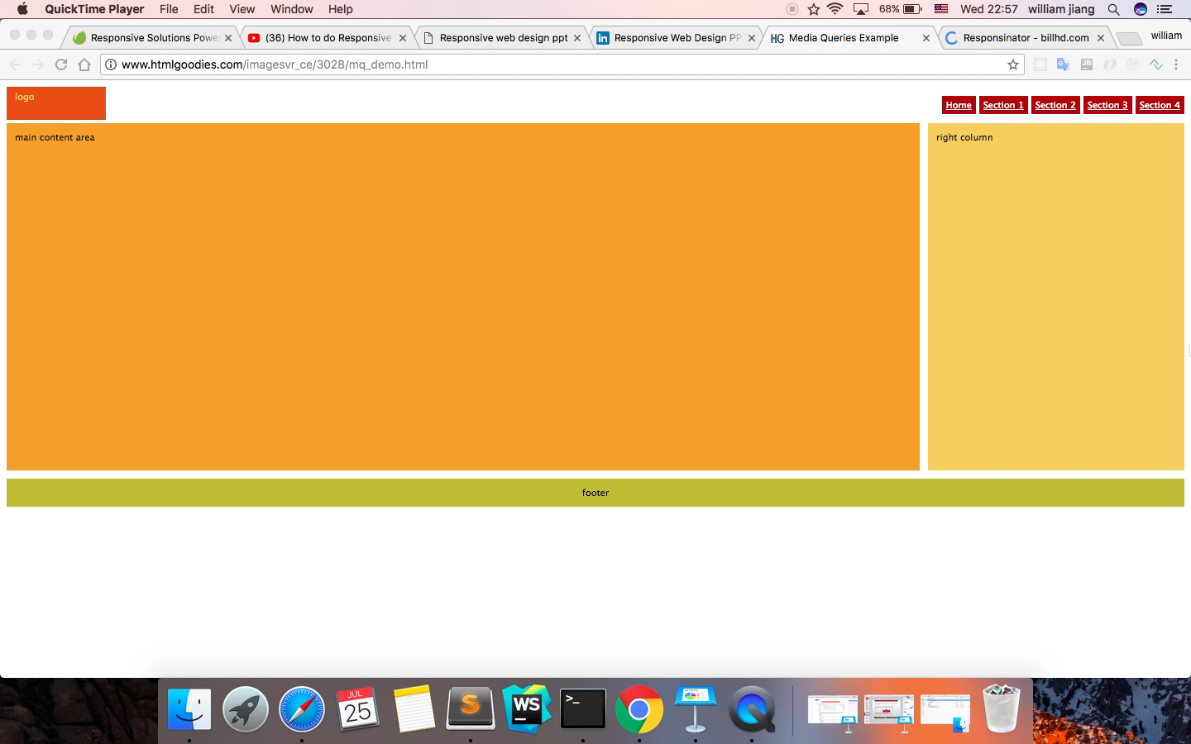
HSBC业务线

Slide 18
设计原则：Mobile First
Mobile experience should be the first one created.
Spearheaded by Luke Wroblewski.
Three reasons why:
  Mobile is exploding
  Mobile forces you to focus
  Mobile can extend your capabilities

Slide 19
Mobile is exploding
A proliferation of mobile devices worldwide.
More and more people access Internet only through mobile devices.
Estimated by the year 2020, 12 billion mobile subscriptions.
MF ensures you have an experience available to extremely fast-growing user base - the next big computing platform.

Slide 20
Mobile forces you to focus
Requires design team to focus on most important content, data, and functions.
No space in a 320 by 480 pixel screen for extraneous, unnecessary elements.
Forced to focus on content that's most important to users.
  What features and functionality are essential?
  If it is nice to have, then does it belong on your page?
Designers must prioritize.

Slide 21
Mobile extends your capabilities
Mobile first allows designers to use full capabilities of device.
"Saying mobile design should have less is like saying paperbacks have smaller pages, so we should remove chapters.” (Clark)
Use of geo-location to optimize the experience.
Switch layouts depending on the way they're held.
Rich, multi-touch interface.
Provide a rich user experience.

Slide 22
RWD vs. Mobile Optimized
Responsive Design | Mobile Optimized
One Design with Fluid Layouts | Layouts are Device Specific
Easy to Maintain and Update | Two Sets of Content to Update
Easier to Configure for SEO | Complicated to Optimize for Search
Menus, Images, Nav Hide or Shrink | Simplified Nav, Smaller Images Only
Looks Good on All Devices | Mobile-Centric Experience
Potentially Slow Load Times | Faster Load Times
Better for Complex Content | Simplified, Streamlined Content
More Expensive but Lasts Longer | Less Expensive, Frequent Updates
Keep One Domain | Two Domains

Slide 23
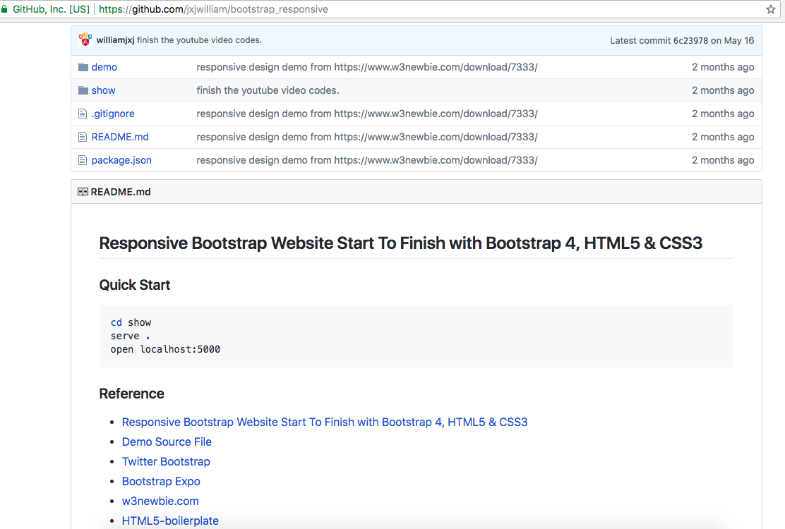
https://github.com/jxjwilliam/bootstrap_responsive

Slide 24
